Slide 1
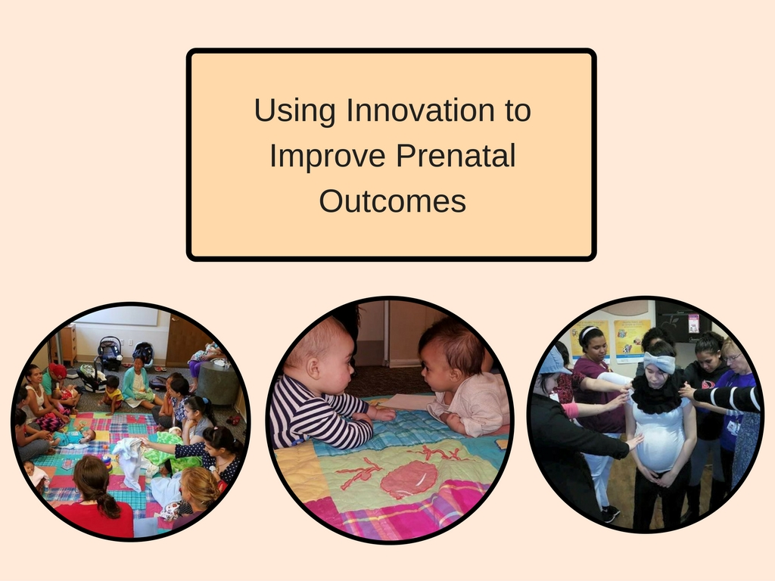

Slide 2
Participants will…
Understand the diversity and unique needs of patients receiving care at a local Federally Qualified Health Center
Learn about the philosophy and conceptual framework of CenteringPregnancy® and CenteringParenting®
Be informed of the Highmark Foundation’s level of participation in reaching overall improved maternal/pediatric goals
4. Understand integrating supportive measures into the Centering® model of care

Slide 3
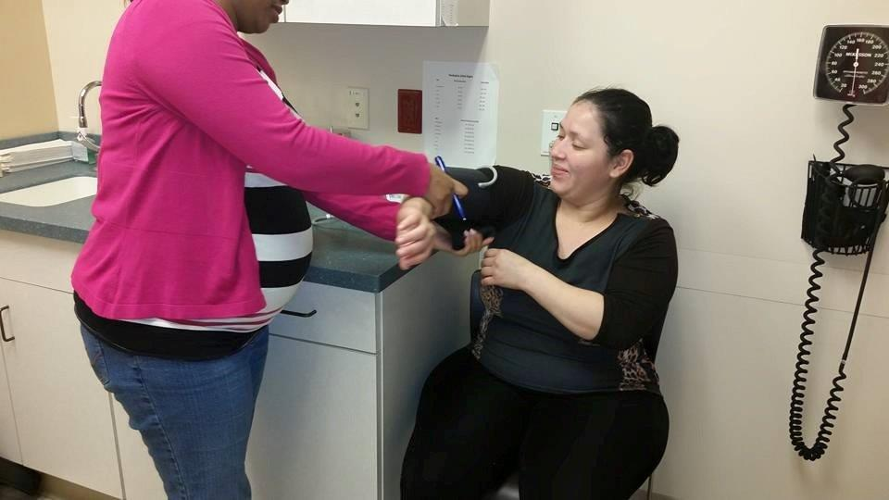
SouthEast Lancaster Health Services
For 42 years, SouthEast Lancaster Health Services has offered high-quality and compassionate medical and dental care to all in our community, regardless of economic status.

Slide 4


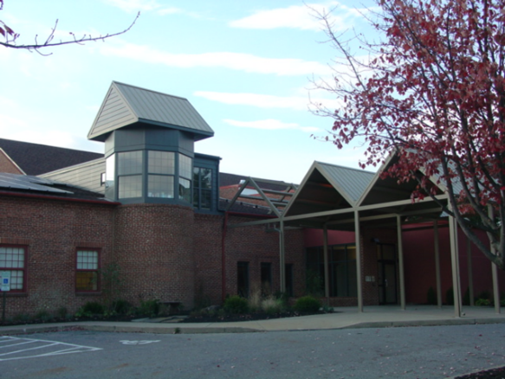
We have five sites:
Our two main sites - North Arch Street and South Duke Street
Philhaven and SouthEast Lancaster Health Services Center for Integrated Healthcare
A medical office inside of the Bright Side Opportunities Center and Reynolds Middle School - both of which act as a hub for refugee families new to the U.S.

Slide 5
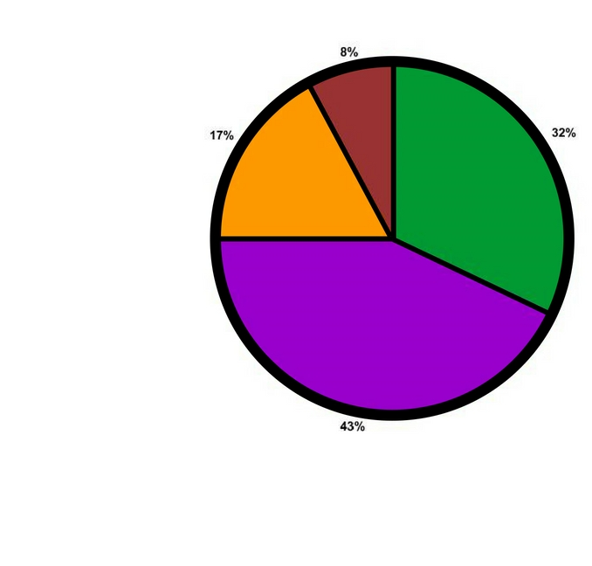
Demographics of SouthEast Lancaster Health Services patients [2015]
Caucasian
Hispanic/Latino
African/African American
Asian

Slide 6
Centering® at SouthEast Lancaster Health Services
Group prenatal care was started by Centering® trained providers in 2008 at our Duke Street location with only one pregnancy group per year
In 2012 we expanded our CenteringPregnancy® groups and included CenteringParenting®
Centering® is a model of care established through the Centering Healthcare Institute (CHI) in Boston. In 2013 SouthEast Lancaster Health became a CHI certified site and in 2015 was approved for in-house staff training

Slide 7
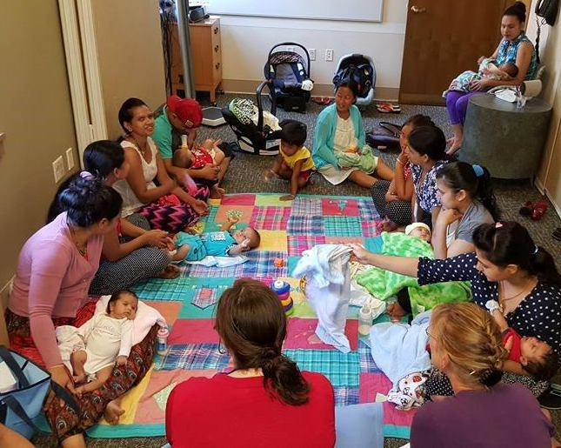
Between 2014-2016 we have run 22 Centering Pregnancy® and 25 Centering Parenting® groups split into English, Spanish, and Nepali language groups.

Slide 8
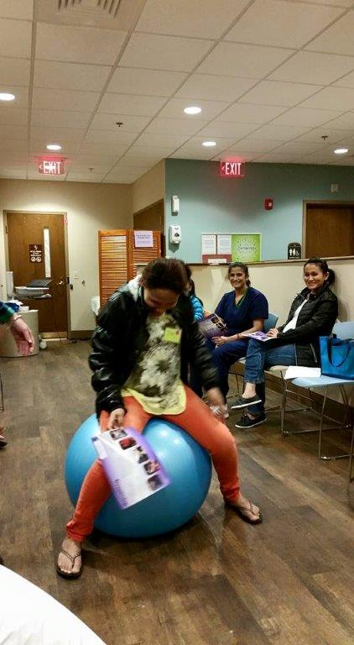
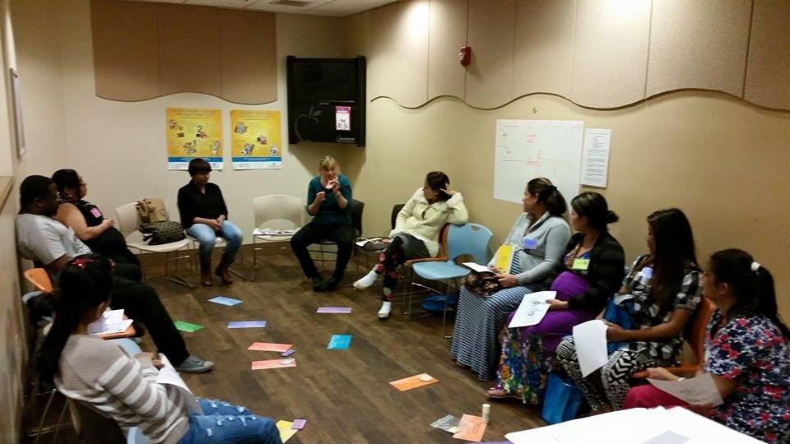

Slide 9
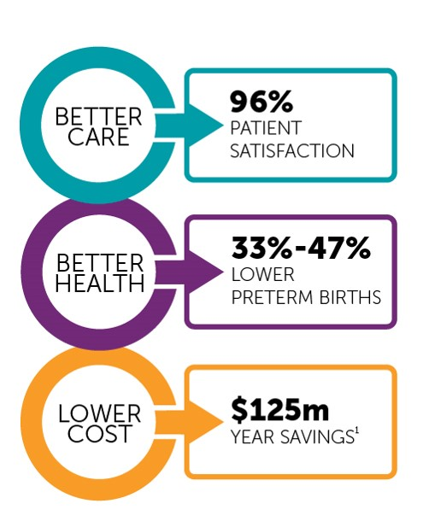
Achieving the Triple Aim

Slide 10


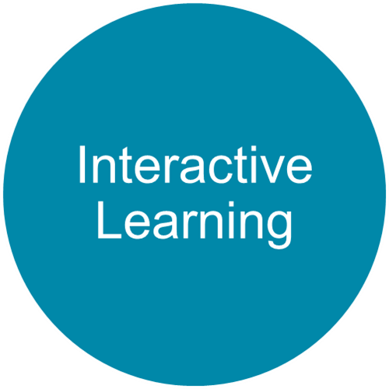
Components of Centering®
Notes:
3 components of Centering: health assessment, interactive learning and community building.
Health Assessment
Centering includes the traditional health assessment, screenings, exams, tests, and treatments. Patients take part in their own assessment and have private time with their provider.
Interactive Learning
Participants come together with their provider for discussion and activities that explore important health and wellness topics. People learn best when they are in conversation.
Community Building
One person’s question is another one’s question and individuals quickly find comfort in knowing they are not alone in their feelings. People from varied backgrounds come to appreciate shared goals for health and well-being and the chance to learn from one another.
Centering offers benefits to:
Patient: No waiting, time for sharing and learning, a community of friends
Provider: Needing to say things only once, working with really activated patients, finding work fun and energizing
Administrators: Better access for your patients, great marketing program, better birth outcomes, predictable clinic time schedules
Two models:
CPregnancy
CParenting …

Slide 11

8 -12 women with similar due dates
follow recommended schedule of 10 prenatal visits:
Four sessions, every 4 weeks | 16, 20, 24, 28 weeks
Six sessions, every 2 weeks | 30, 32, 34, 36, 38, 40 weeks

Slide 12
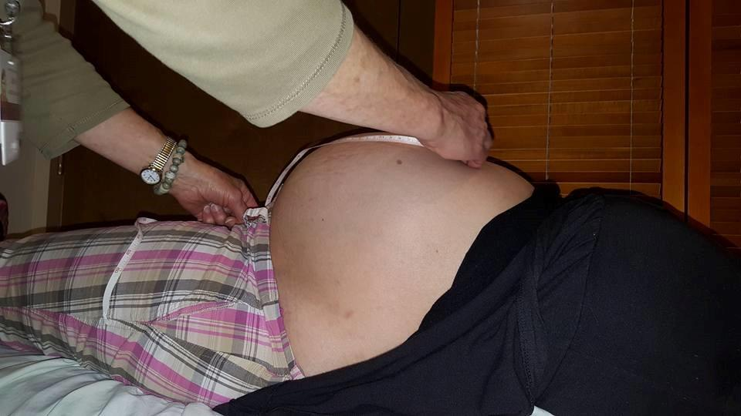
Demographics of the population served in CenteringPregnancy® groups [2016]
Age
Gender
<20 17%
20-24 34%
25-29 29%
>30 20%
100% female
Race/ethnicity
Insurance
Hispanic/Latino 69%
Commercial
9.0%
Medicaid
82.1%
Not Hispanic/Latino 31%
Medicare
3.0%
uninsured
6.0%

Slide 13

6-8 parents & babies
Continue care from Centering Pregnancy® group or as standalone model of family centered well-child care
Visits align with current Bright Futures, AAP schedule:
by 1 month, 2, 4, 6, 9, 12, 15, 18 and 24 months
Flexibility to schedule additional visits

Slide 14
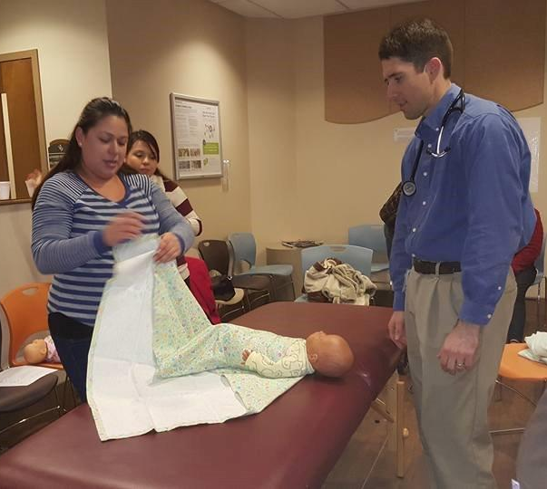
Demographics of the population served in CenteringParenting® circles [2016]
Age
Race/ethnicity
<20 17.1%
20-24 28.6%
>30 21.4%
Hispanic/Latino 52.1%
Not Hispanic/Latino 42.3%
Gender
Children: Parents:
Male 49.3% 0.0%
Female 50.7% 100%
Insurance
Children: Parents:
Commercial 2.8% 8.6%
Medicaid 94.4% 81.4%
Medicare 0.0% 2.9%
Uninsured 2.8% 7.1

Slide 15
Centering® Framework
*Each session includes elements of health assessment, education and support.
Education topics for CenteringPregnancy® circles include:
Mental health
Family planning
Breastfeeding
Relationships
Safe sex
Oral health
Weight management
Life balance
Infant attachement
Postpartum care
Education topics for CenteringParenting® circles include:
Infant growth and development
Immunization
Nutrition
Illness
Oral health
Safety

Slide 16
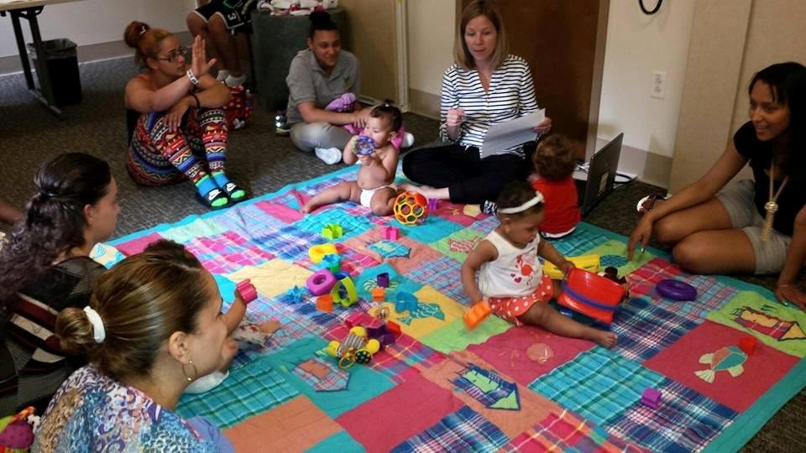
Other factors that contribute to the success of these Centering Pregnancy®
*Education and support can be provided in a culturally-competent manner.
- Multilingual providers and support staff
    - Facilitate groups in language of choice
    - Cultural beliefs are addressed and honored
*Great diversity of patient ages benefits entire group
- Wisdom from more seasoned mothers
    - Enthusiasm and openness to learning from
    young first time mothers

Slide 17
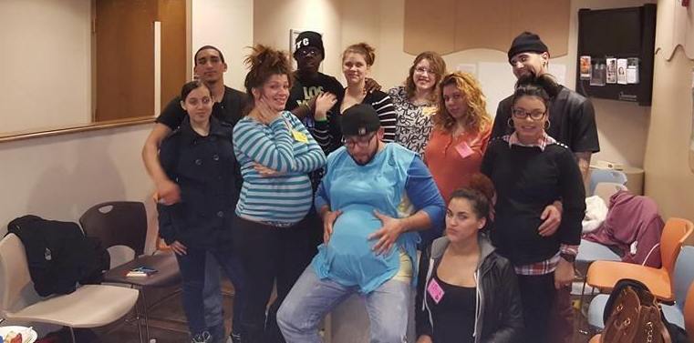
When patients come in for routine one-on-one and acute visits, providers have limited time to assess any psychosocial needs that might need to be addressed to support physical health.
This unique prenatal/parenting visit setting and structure gives providers and patients a more relaxed atmosphere where topics can be discussed within the group.

Slide 18

We use Centering Parenting® as a follow-up for those who have completed CenteringPregnancy®
* Offers a continuing community for almost two years
* Provides an opportunity to teach competence and build confidence as a new parent
* Offered to parents who were not enrolled in a CenteringPregnancy® group as well
.

Slide 19
Highmark Foundation’s mission:
To provide health assessment - including teaching women to assess their own and their infants’ health
To offer education on pertinent topics through facilitated discussion
To offer patients added support from their trusted provider, and a group of peers

Slide 20
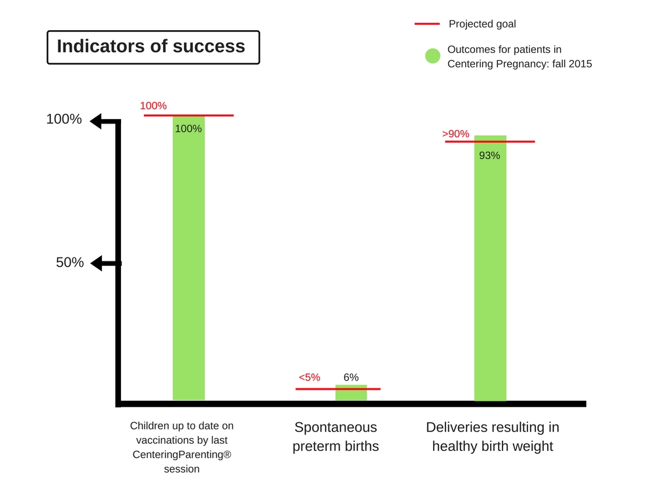
®

Slide 21

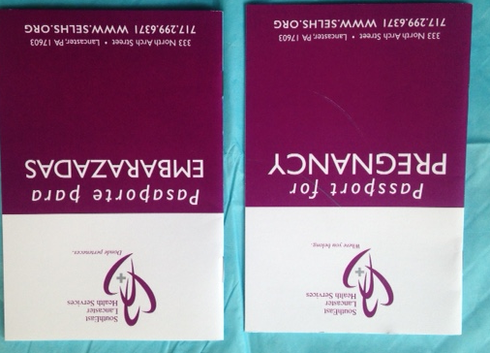
Support of Centering®
OB education (videos, passports, handouts, etc)
Incentives
Supporting administrative hours

Slide 22
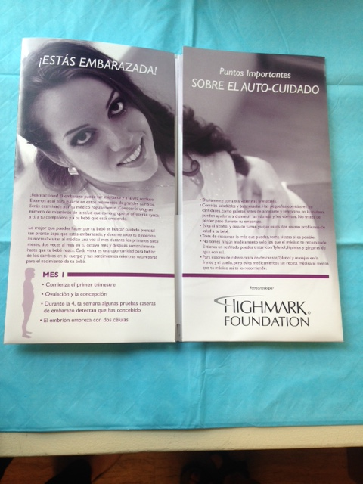



Slide 23
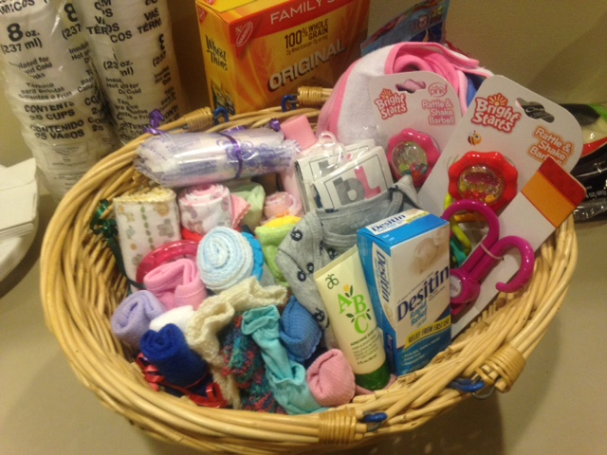

Slide 24
Supplemental support
At SouthEast Lancaster Health, we were particularly interested in offering affordable Women’s Healthcare which also incorporates leading edge, best practices. We’ve melded an economically prudent model of care with whole person enrichment services that are typically available only to affluent women:
Childbirth Education Classes
Lactation support
Prenatal yoga
Birth Doula Services

Slide 25

Childbirth Education Classes
Birthing classes with a local certified CBE in both natural and medicated birthing

Slide 26
Curriculum (over 2 class periods):
Anatomy and Physiology
Signs and Symptoms of Labor
When to go to the Hospital
Relaxation Techniques
Stages/Phases of labor
Medical Procedures & Medications
C-Section Discussion
Immediate Postpartum

Slide 27
CBE at SELHS
Cultural issues
Language concerns (Spanish/English)
Poor show rate standing on its own: total of 9 classes (offered 5 in English and 4 in Spanish) – out of 31 participants only 10 completed entire class series
Beginning in 2016 incorporated syllabus into CenteringPregnancy® circles which have proven to be a successful format

Slide 28
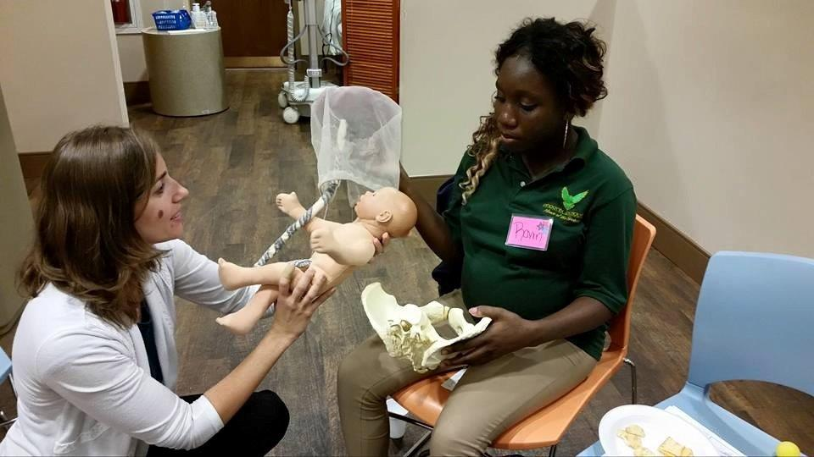
“I had a SELHS Childbirth Class one-on-one because of my schedule. It was worth it and I really needed that. I was able to ask so many questions I had on my mind and that it prepared me better for the birth of my son.” – Nancy S.

Slide 29
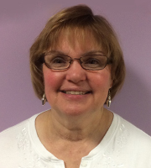
Lactation Support
Counseling and support from lactation consultant for the mother before and after the birth of the baby

Slide 30
Lactation consultant at SELHS
Offered 2 breastfeeding classes
Increased support of breastfeeding and troubleshooting problems
Made routine check-in calls to patients postpartum
Inspired local staff to pursue education as lactation community support (Spanish/Nepali)
Eventually incorporated syllabus into CenteringPregnancy® circles which has proven to be a successful format

Slide 31
What was the most important thing you learned about breastfeeding by coming to class?
“Everything really, but what most interested me was breastfeeding seems easy if cared for and done correctly.”
“It’s the most nutritious for the baby.”
“I know what to look for to make sure my baby is getting enough milk.”
“How to hold the baby best while feeding.”
“All the information was helpful and supportive. It made me feel excited to breastfeed!”

Slide 32
Breastfeeding Rate (%) 2011 vs 2016)
P value: <0.0001 0.0005 0.3189 0.0967 0.0006 <0.0001 <0.0001 <0.0001
Where red values are significantly different at a 95% confidence interval

Slide 33
Lactation support made a difference in breastfeeding length
Wilson Rank Sum Test for Breastfeeding Length vs All Forms of Lactation Support
% breastfeeding
Lactation Support

Slide 34
Centering Pregnancy/Parenting on Breastfeeding Length
Wilson Rank Sum Test for Breastfeeding Length vs Centering Pregnancy/Parenting
% Breastfeeding
Participation in Centering Pregnancy/Parenting

Slide 35
SELHS Lactation Consultant on Breastfeeding Length
% Breastfeeding

Slide 36

Prenatal Yoga
A partnership with a yoga studio next door to our health center (West End Yoga) for prenatal and ‘Mommy and Me’ yoga classes

Slide 37
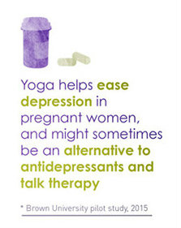

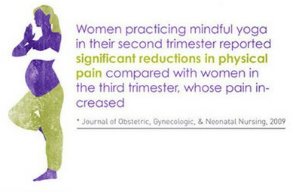
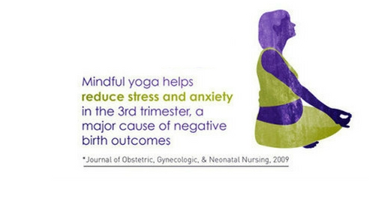


Slide 38
Prenatal Yoga at SELHS
Cultural Issues
Religious Issues
Social Issues
Most of our international patients do not recognize yoga as “self care” or valued method as exercise.
Patients reported being suspicious and uncomfortable with spiritual themes present in practice of yoga.
Patients could not find babysitter, time off work, or motivation to attend studio classes.

Slide 39

Birth Doula Services
Hands on, continuous birth support, offered to patients at SouthEast Lancaster Health Services when they deliver at Women and Babies Hospital

Slide 40
Continuous Labor and Delivery Support
Published data indicates that one of the most effective tools to improve labor and delivery outcomes is the continuous presence of support personnel, such as a doula.
A Cochrane meta-analysis of 12 trials and more than 15,000 women demonstrated that the presence of continuous one-on-one support during labor and delivery was associated with improved patient satisfaction and a statistically significant reduction in the rate of cesarean delivery.* Given that there are no associated measurable harms, this resource is probably underutilized.
*Hodnett ED, Gates S, Hofmeyr GJ, Sakala C. Continuous support for women during childbirth. Cochrane Database of Systematic Reviews 2013, Issue 7. Art. No.: CD003766. DOI: 10.1002/14651858.CD003766.pub5

Slide 41
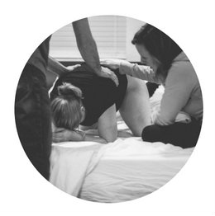
Women in the study who received continuous labor support:
Had slightly shorter labors
Were less likely to use pain medications
Were more likely to give birth ’spontaneously’ (i.e. give birth with neither caesarean nor vacuum nor forceps)
Delivered babies that were less likely to have low five-minute
Apgar scores
More satisfied with their experience overall

Slide 42
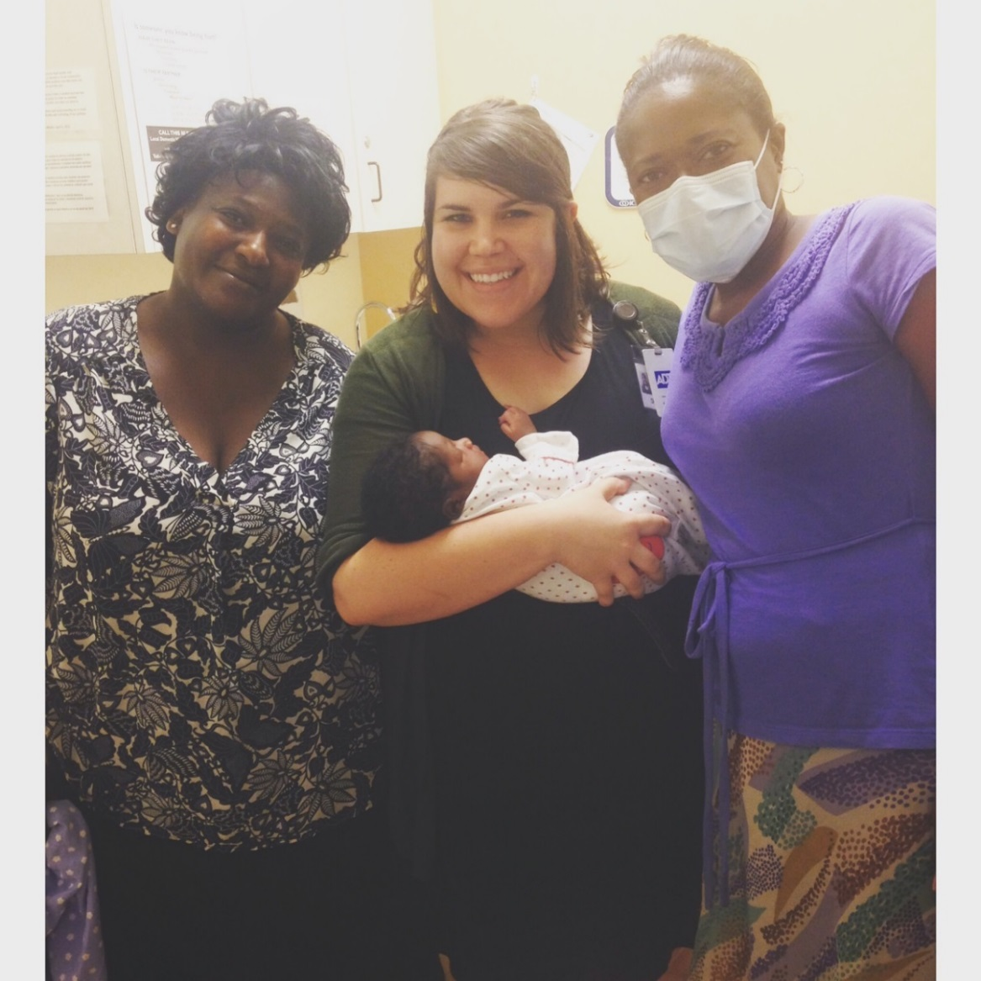
Doulas at SELHS
Doulas attended 34 births over one year period – free of cost to the patient
Worked with patients from 14 different countries

Slide 43
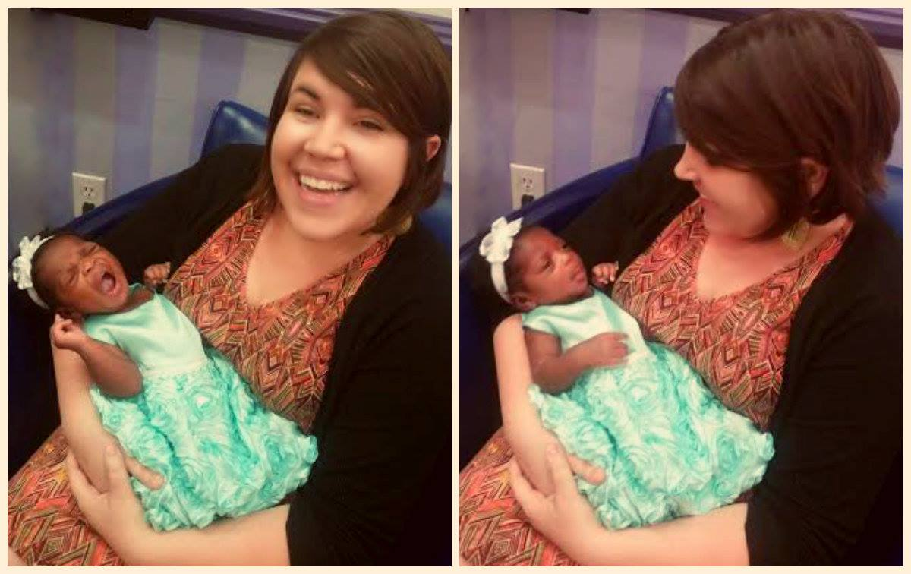
How Doulas paired with patients:
Provider flagged high risk patient in need of support and connected them to doula services
Doulas present at CenteringPregnancy® groups and review hands on pain relief techniques
Doula services include: meeting twice prenatally, on call starting at 37 weeks until the baby was born, and one postpartum visit
Doulas meet in patients home if they are comfortable hosting

Slide 44
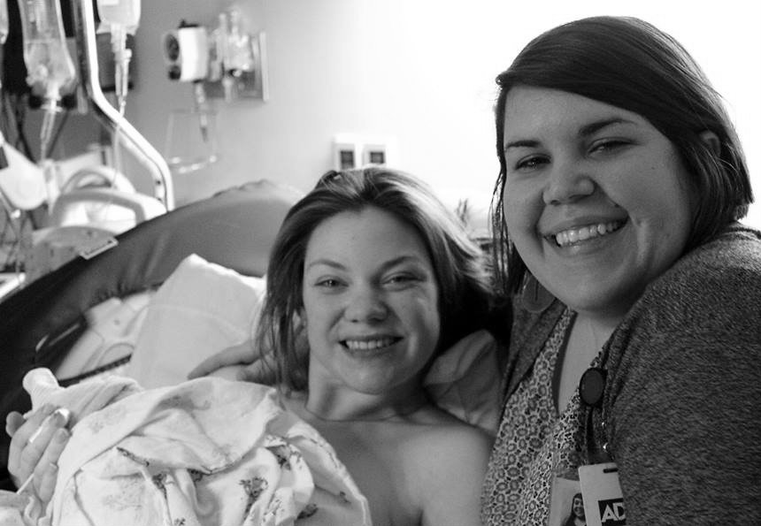
Doulas at SELHS
Had to contextualize the role for refugee and immigrant patients
Doulas were granted permission to accompany patients from Lancaster prison in labor at WBH
Helped guide patients through inductions, cesarean sections, fetal demise, addictions, adoptions, and teenagers with general lack of family and social support

Slide 45
SELHS patients who used Doula services
67% considered medically high risk (GDM, IUGR, AMA, VBAC, HELLP syndrome, preeclampsia, etc)
17% C-section rate - 6% of these were scheduled repeat surgeries
77% did not speak English as a first language - if they could even speak English at all
44% chose to utilize an Epidural for pain medication and 30% had completely unmedicated labors
11 women of the 34 doula patients had absolutely no family or friend support and would have been delivering completely alone in the hospital if the doula had not been there

Slide 46
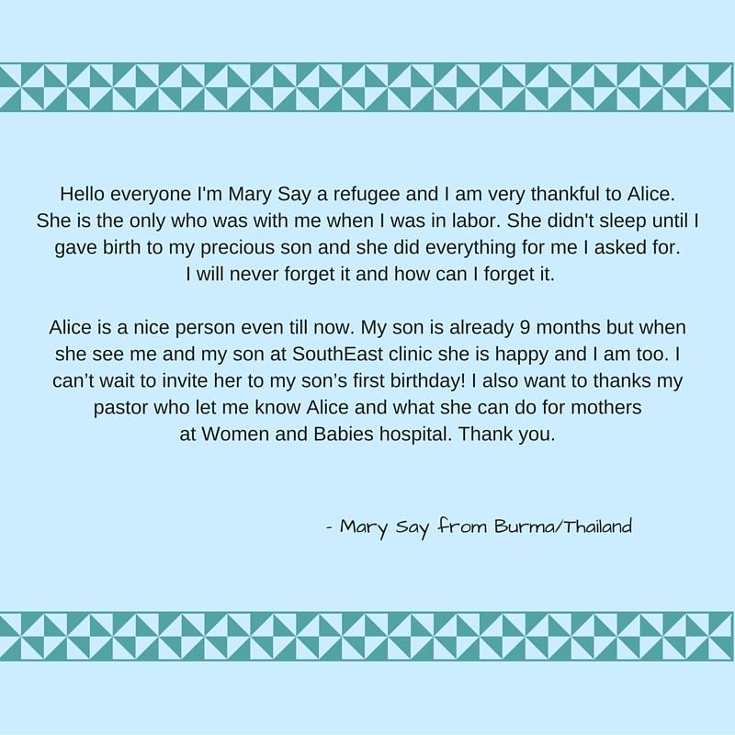
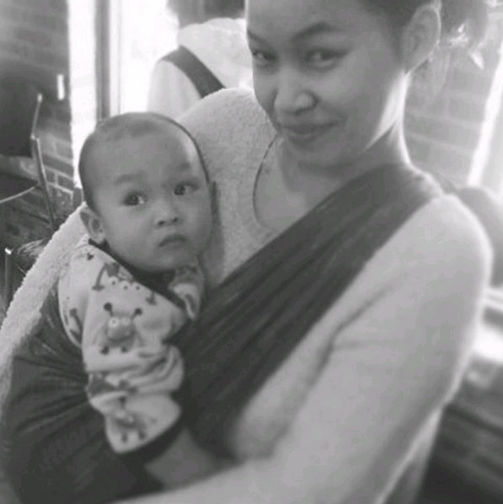

Slide 47
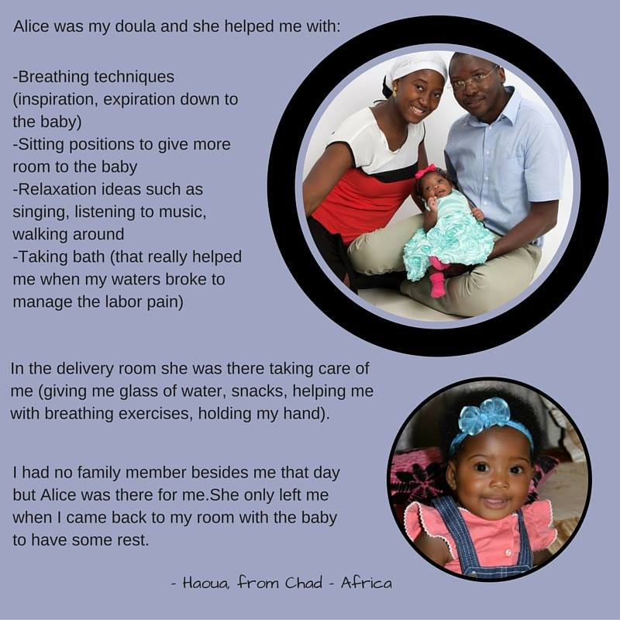

Slide 48
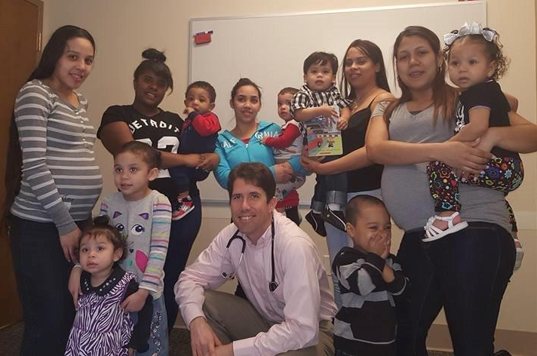

When women have a good support base – medical, family and friends – they take care of themselves and hold each other accountable.

Slide 49
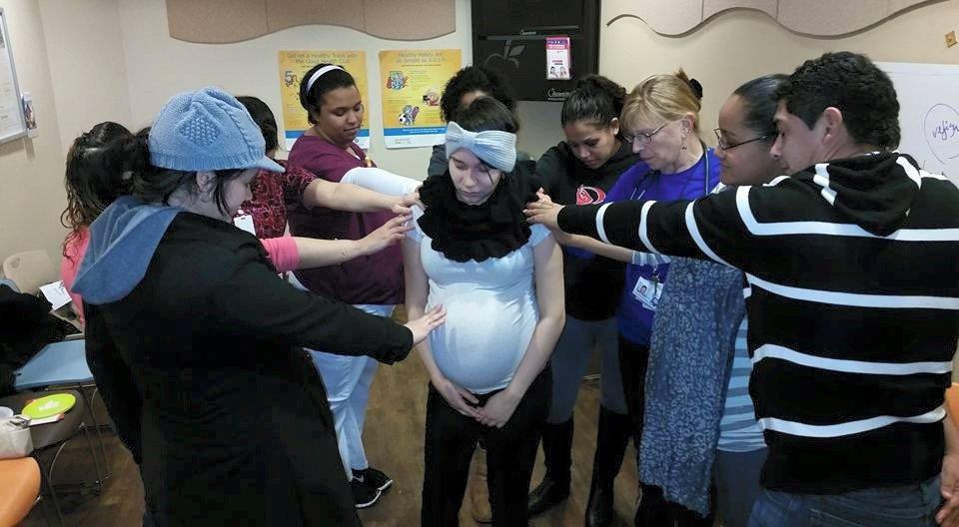
As patients gain trust in the facilitating provider and in each other, a support system forms in the group. Being part of a supportive group means a sense of belonging, and we observe that when women know they are not alone they are better able to take care of themselves and their families.

Slide 50
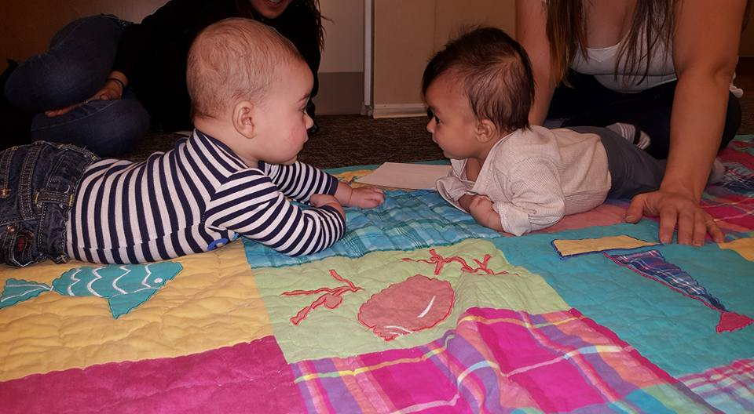
Friends for life! The value of community in action…

